Slide 1




ABACUS GLOBAL
ESS
A SMART SOLUTION FOR PREDICTING ENVIRONMENTAL ANOMALIES.
Presented By:
MEKAILL MURTAZA

Slide 2
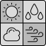
INTRODUCTION
ENVIRONMENT AND COMFORT
Personal comfort has been a long sought after goal for humanity.
Generally, if local conditions are just right, everyone in the area feels satisfied. Yet, there are times when local opinion does not match official data at all.
This means that regions with seemingly perfect environments find themselves suddenly abandoned by tourists.
Fast, dynamic responses
are necessary for tourist reliant cities and industries. To match these demands, it is necessary to harness the power of digital twins and AI to fill the gap when regular data cannot.

Slide 3


SOLUTION
The ESS system simulates environmental data in real-time, all while gathering subjective local views as well.
This is coupled with a robust predictive system that uses past data to simulate what locals would be expected to feel.
This immediate detection enables operators to act quickly, addressing issues before they escalate into broader dissatisfaction or tourist decline.
Dealing with Rapid Environmental Changes
Detecting Dissatisfaction Early
Increasing Tourist Loyalty and Satisfaction

Slide 4







ARCHITECTURAL DIAGRAM

Slide 5
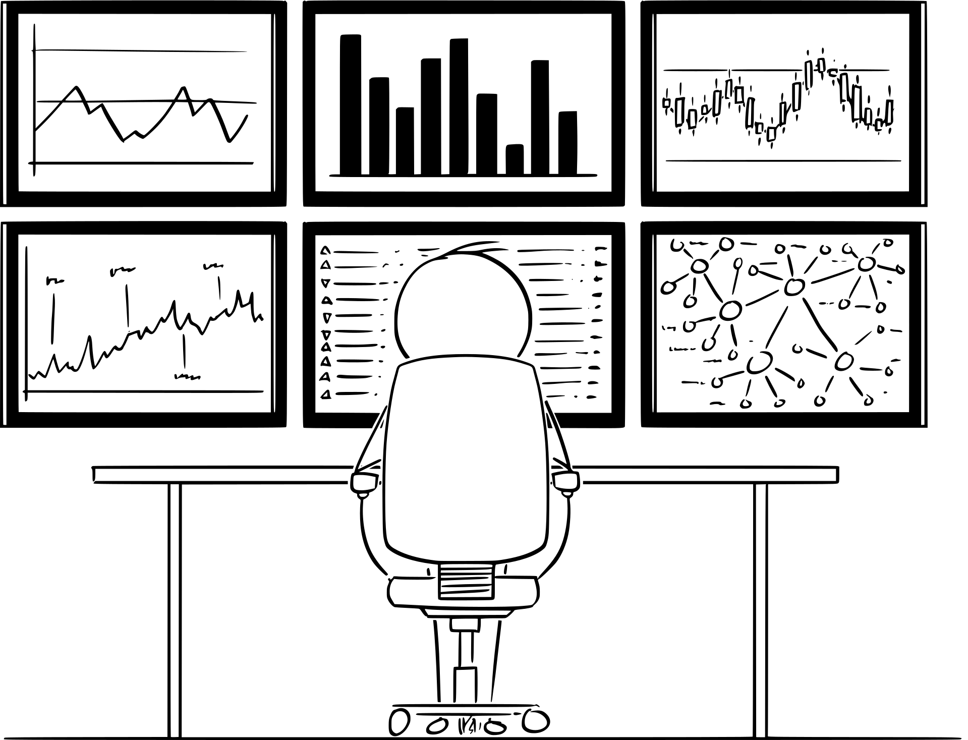





DATA SOURCING
ESS sources live temperature data from OpenWeather, a UK-based company that provides live weather data.
Live air quality data is sourced from aqicn.org.
Live local comfort views are obtained using a proprietary Flutter based Android app
Sonamarg, Kashmir - A tale of deceptive weather.
Due to the unavailability of free historical data, past local views & historical AQI data for Lahore, Islamabad and Karachi have been simulated.
Further Data Usage
A once thriving ski resort has found itself abandoned. Despite weather conditions appearing perfect on the surface, climate change has caused snowfall patterns to become erratic, making is unsuitable for winter sport.
Storage in InfluxDB v2.x
Visualization with Grafana
Here, digital twin systems such as ESS would have allowed operators to observe subtle changes, by comparing predictions to current local comfort. Thus making further investigations and changes in investment strategy possible before it was too late.
Smart predictions with Scikit-Learn

Slide 6
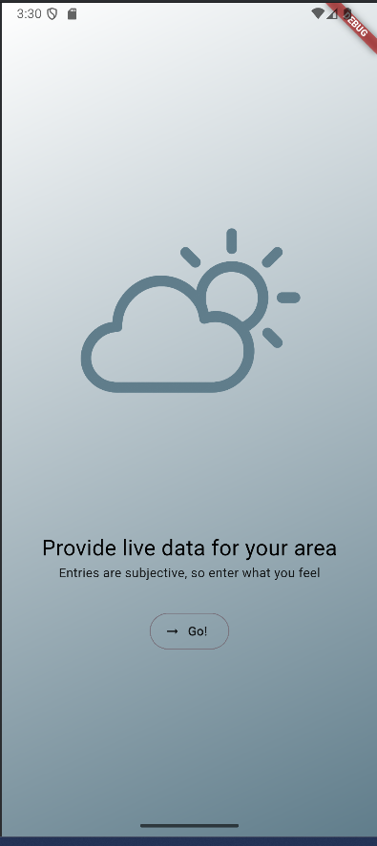


FRONT-END: FLUTTER
Flutter provides an easily maintained framework to build and maintain apps, proving to be a robust solution for a user-facing app for locals to enter current information about their comfort.
This data is sent directly to Influx via Node-RED.
Provides a simple, user friendly interface
Supported by all modern Android devices
Connects easily to Node-RED

Slide 7




THE BACKBONE: NODE-RED
Node-RED is a js-based visual editor that allows for hardware, APIs, and online services to be configured into event-driven flows.
ESS uses Node-RED to connect its data sources to their endpoints.
Why Node-RED?
Further Connections
Provides a robust, open source architecture
SCIKIT-LEARN
INFLUX DB
Supports a wide range of tools, databases and frameworks

Slide 8





THE DATABASE: INLFUX-DB
Node-RED sends API Data to Influx
InfluxDB is an open-source time series database developed by InfluxData, optimized for the efficient storage, querying, and analysis of timestamped data. In this case, these are temperature, US API and local satisfaction.
Scikit-Learn uses this to make predictions
ESS uses separate buckets for each city, to store and retrieve live timestamped data in real-time
Grafana pulls this data to visualize it

Slide 9


PREDICTIONS: SCIKIT-LEARN
Scikit-Learn is a Python-based library that provides numerous easily configurable statistical and machine learning algorithms.
ESS uses a random forest model to make informed predictions on current local comfort.
Leveraging Scikit-Learn for state-of-the-art algorithms
ADAPTABLE, EASILY TRAINED MODELS
EXTENSIVE DOCUMENTATION & SUPPORT
STRONG INTEGRATION WITH PYTHON

Slide 10



RANDOM FOREST MODELLING
The Random Forest algorithm builds a forest of decision trees, training on a random bootstrap sample of data and considering only a random subset of features at each split. It aggregates their outputs via majority vote (for classification) or average (for regression).
Notes:
1.
Human comfort drives tourism, but perceived local conditions can diverge sharply from official data, causing sudden visitor drops.
Tourism-dependent cities therefore need fast, dynamic response systems because traditional datasets often lag or miss local sentiment.
Digital twins and AI offer real-time localized simulations and sensor/social-data fusion to predict perception-driven risks and trigger targeted operational or communication interventions.

Slide 11
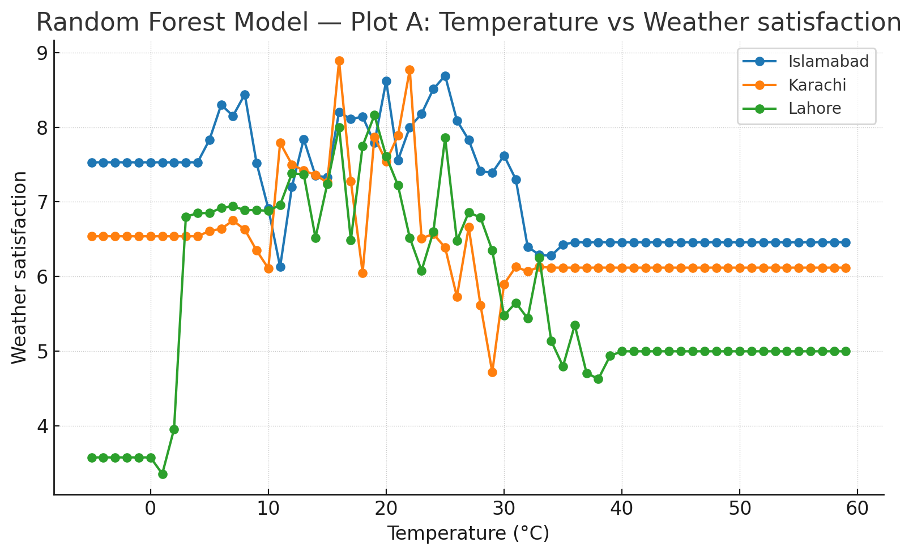
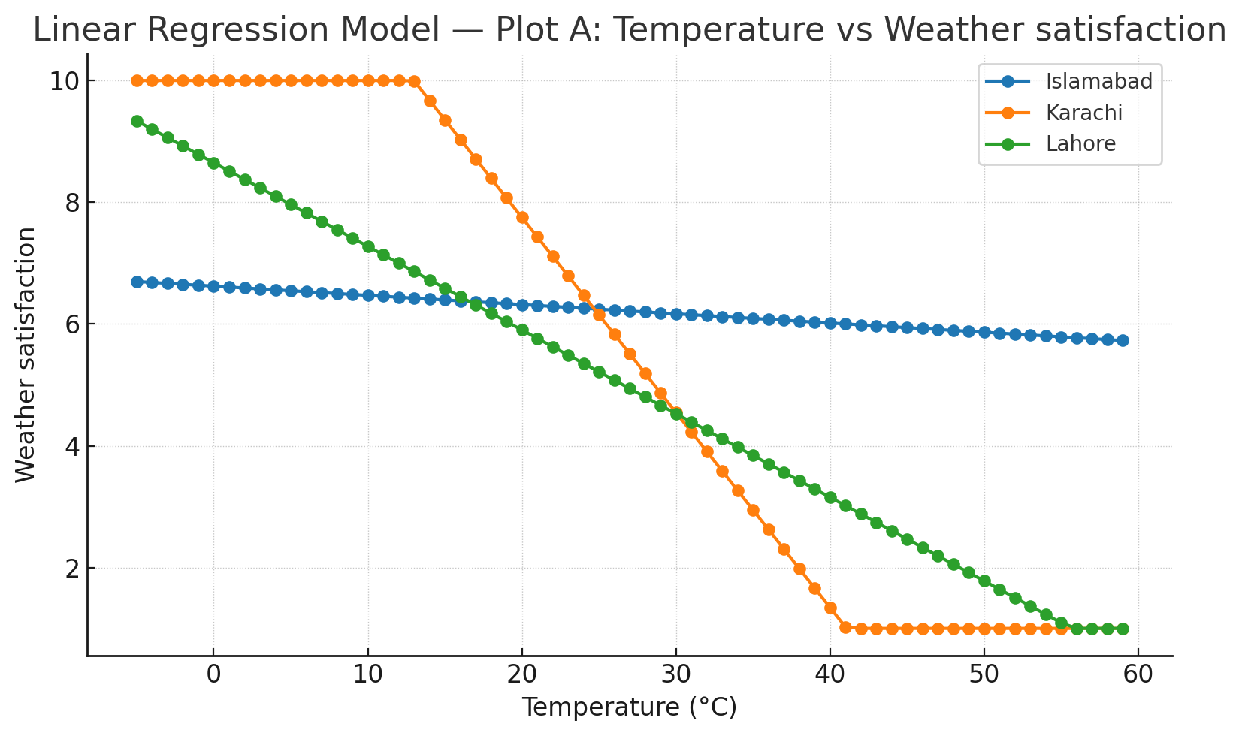
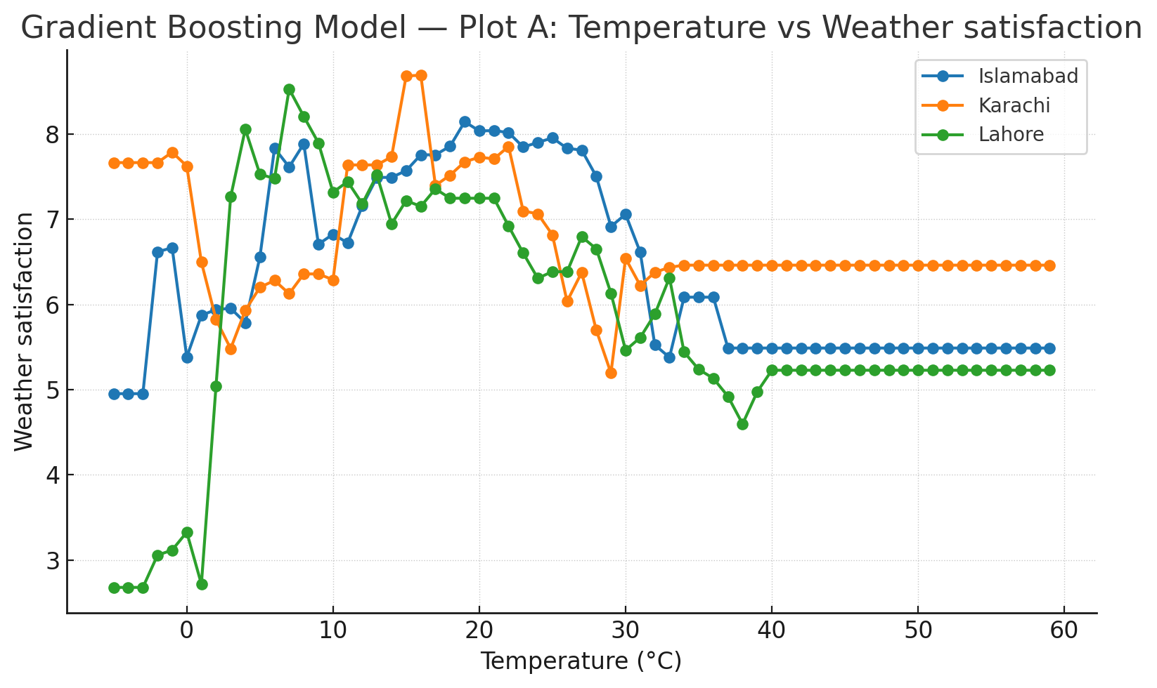
TESTS: TEMPERATURE
The random forest model was chosen after tests with numerous other algorithms, those being linear regression, and gradient boosting.
The results are shown, with the predicted satisfaction value on the y axis, and the input temperature value on the x-axis.
The tests were run for a range of temperatures, from -5 to 60 degrees Celsius.

Slide 12
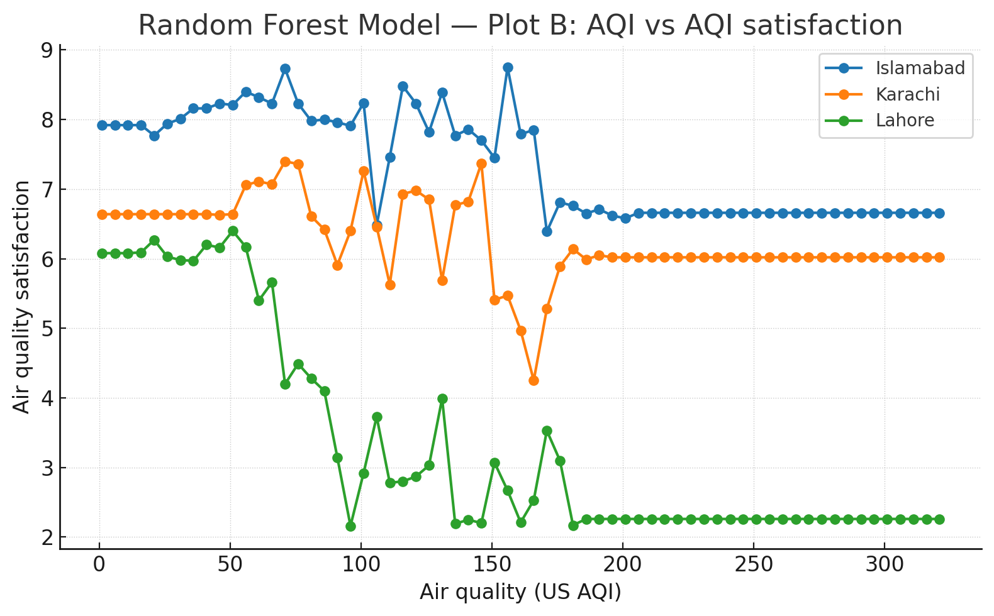
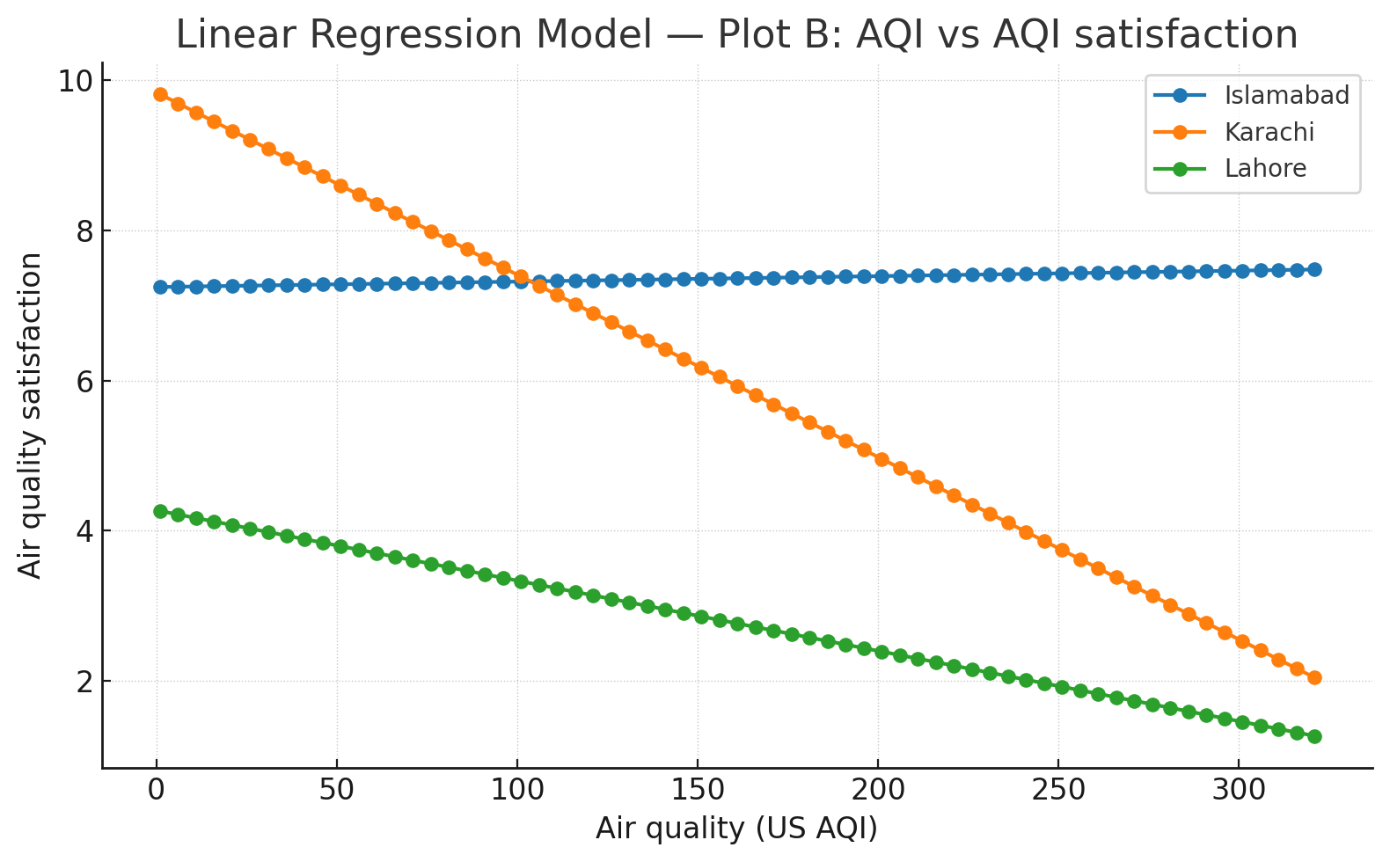
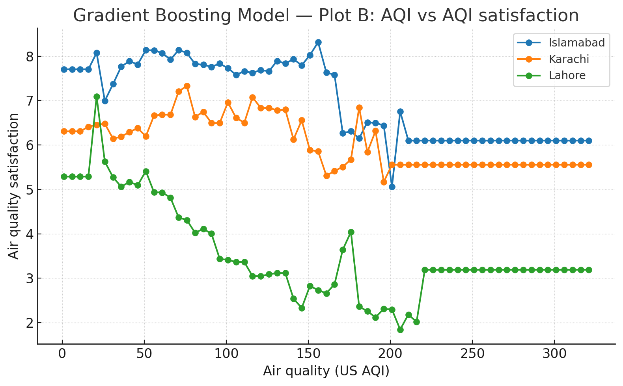
TESTS: US AQI
The random forest model was chosen after tests with numerous other algorithms, those being linear regression, and gradient boosting.
The results are shown, with the predicted satisfaction value on the y axis, and the input temperature value on the x-axis.
The tests were run for a range of AQI levels, from 0 to 350.

Slide 13




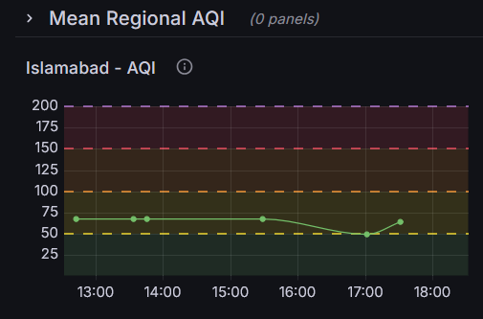


VISULAIZATION: GRAFANA
Grafana is an open-source, multi-platform web application for querying and visualizing data, all via customizable dashboards.
It supports a direct connection with InfluxDB, allowing for a robust, streamlined connection.
The ESS dashboard allows operators to monitor five distinct metrics across three Pakistani cities, Lahore, Islamabad and Karachi.
Real-time Analytics
Automated Updates
Dynamic Predictions
Tailored Display

Slide 14
DEMONSTRATION
EVALUATION

Slide 15
CONCLUSION
AND RECOMMENDATIONS
ESS is perfect for data-driven decisions in the tourist industry, providing operators with analytics that allow them to respond as soon as tourists begin to feel discomfort.
This can potentially vast amounts of

Slide 16

THANK YOU
FOR YOUR ATTENTION AND PARTICIPATION

